Slide 1
Software Engineering
By: M.Aamir Saleem
amir.saleem@gift.edu.pk

Slide 2
S/W Quality Engineering
What is Quality ?
What is Software Quality?
Basic concepts of Software Quality
Software Quality Overview
Importance of Software Quality
Software Quality Types
SQA & SQC

Slide 3
What is quality?
The degree to which a component, system or process meets specified requirements and/or user/customer needs and expectations.”
A degree of excellence
Conformance to requirements
Freedom from defects
Delighting customers
An iterative process of trial, testing and feedback on performance

Slide 4
Garvin's Quality Perspectives
Transcendental Perspective
Manufacturer Perspective
User perspective
Product view
Value-based view

Slide 5
Key aspects of quality
Good design – looks and style
Good functionality – it does the job well
Reliable – acceptable level of breakdowns or failure
Durable – lasts as long as it should
Good after sales service
Value for money

Slide 6
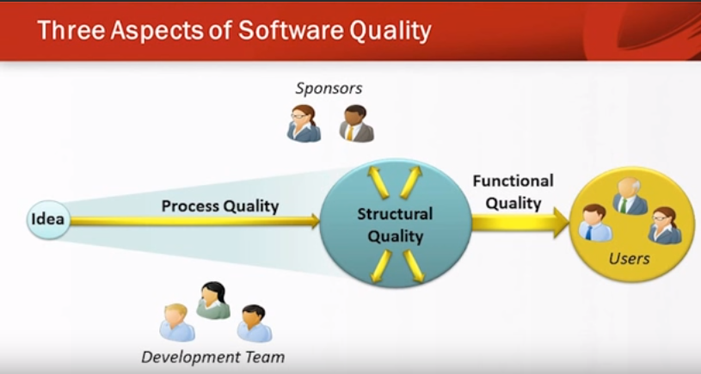
What is software quality?

Slide 7
What is software quality?
Functional Quality
Meeting the specified requirements
Few Defects
Good enough performance
Ease of learning and use
Mainly handled by Testing
User are more interested in this aspect of s/w quality

Slide 8
What is software quality?
Structural Quality
Code Testability
Code Maintainability
Code Understandability
Code Efficiency
Code Security
Development team is more interested in this aspect of s/w quality

Slide 9
What is software quality?
Process Quality
Meeting Delivery Dates
Meeting Budget
A repeatable development process that reliably delivery quality s/w
Sponsors are interested in all three aspect of s/w quality

Slide 10
What is software quality?
The degree of conformance to explicit or implicit requirements and expectations”
Functional (explicit)
Non Functional(implicit)
Quality software is reasonably bug or defect free, delivered on time and within budget, meets requirements and/or expectations, and is maintainable.

Slide 11
Basic Concepts of Software Quality
Functional: Assured through a set of dedicated quality management activities, which includes quality assurance, quality control and testing.
Non-Functional: Assured through code review, analysis and refactoring.
Software Quality Assurance (Process-focused action)
Software Quality Control (Product-focused action)

